Slide 1


Cloud Computing Workshop Session 3: Kubernetes
Dimitris Kargatzis
Stelios Sotiriadis

Slide 2
Plan for today
Lecture part 1:
What is an orchestrator?
Lecture part 2:
Why do we need to learn about Kubernetes?
What is Kubernetes?
Lab session:
What is the Google Kubernetes Engine (GKE)?
GKE Deployment lifecycle
Deploy a Kubernetes cluster in GCP!
Use Docker to create images and Kubernetes to deploy!

Slide 3
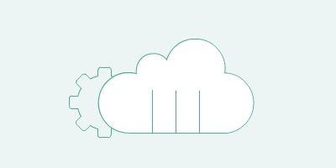
Orchestrators

Slide 4
What is orchestration?
Orchestration is the automated configuration, management, and coordination of computer systems, applications, and services.
Orchestration helps IT to more easily manage complex tasks and workflows.
IT teams must manage many servers and applications but doing so manually isn’t a scalable strategy.
The more complex an IT system, the more complex managing all the moving parts can become.

Slide 5
What is automation?
Automation helps make your business more efficient by reducing or replacing human interaction with IT systems and instead using software to perform tasks
Reduce cost, complexity, and errors

Slide 6
Orchestration and Automation on the Cloud
Automation refers to automating a single task
Push our code to Git
Create a container using Dockerfiles
Orchestration refers to automating processes (workflow ) involving many tasks
Create 100 containers and a load balancer pressing an enter!
Update my software:
From my laptop to production in less than 5 minutes
For orchestration we use Kubernetes!

Slide 7
Why do we need Kubernetes?

Slide 8
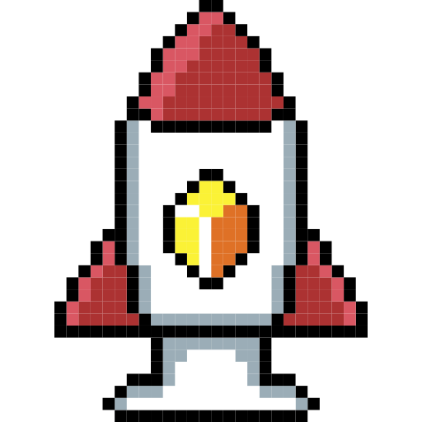
Building the
Mini
Coin
We developed a MiniCoin app and we deployed on GCP in a container!
MiniCoin is a pay-per-use API to provide latest crypto prices
Btw, do you have a good idea about an API?
Check this link.
Our API service is getting popular, and we are doing great!
We move from thousand to tens of thousands of users!

Slide 9
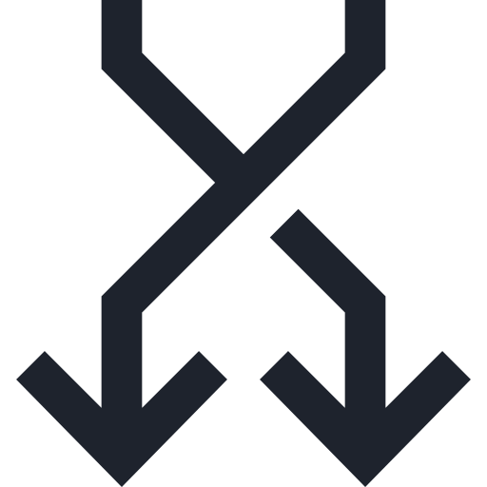
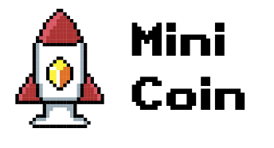
How are app looks like?
10K requests per day!
Traffic is increased!
Good for business
But the VM host is weak, maybe more resources are needed!
Host crashed a couple of times ☹
App is getting slow, latency is increased!
From milliseconds to seconds
What can we do?
Add a second host!
mini-coin-container
node.js backend
Bins/Libs
Docker daemon
VM
GCP

Slide 10
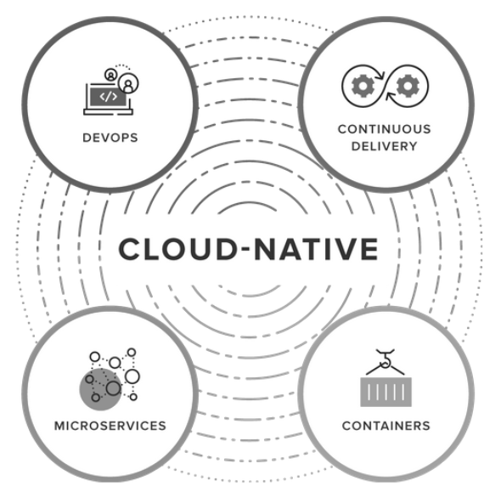
Cloud Native app
A cloud-native application is a program that is designed for a cloud computing architecture.
Briefly an app that is designed and developed considering cloud characteristics:
For example, to support any kind of demand, scale as necessary, be secure, survive failures etc.

Slide 11
Manage traffic/outages
10K requests per day!
?
We use both servers ☺
If one goes down the other is serving
Latency is back to normal!
But… more and more people use our service!
We reach 1M users per day!
What should we do?
Load balancer (minicoin.com)
mini-coin-container-1
mini-coin-container-2
node.js backend
node.js backend
Bins/Libs
Bins/Libs
Docker daemon
Docker daemon
VM
VM
GCP
GCP

Slide 12
We are doing great! Let’s add more…
1M request per day!
Load balancer (minicoin.com)
mini-coin-container-1
mini-coin-container-2
mini-coin-container-3
mini-coin-container-4
mini-coin-container-5
node.js backend
node.js backend
node.js backend
node.js backend
node.js backend
Bins/Libs
Bins/Libs
Bins/Libs
Bins/Libs
Bins/Libs
Docker daemon
Docker daemon
Docker daemon
Docker daemon
Docker daemon
Docker daemon
VM
VM
VM
VM
VM
VM
GCP
GCP
GCP
GCP
GCP
GCP

Slide 13
Again, we are doing great!
Too great… now we need to serve 2M users!
Let’s add more!
Load balancer 1
Load balancer 0 (minicoin.com)
mini-coin-container
mini-coin-container
mini-coin-container
mini-coin-container
mini-coin-container
mini-coin-container
mini-coin-container
node.js backend
node.js backend
node.js backend
node.js backend
node.js backend
node.js backend
node.js backend
Bins/Libs
Bins/Libs
Bins/Libs
Bins/Libs
Bins/Libs
Bins/Libs
Bins/Libs
Docker daemon
Docker daemon
Docker daemon
Docker daemon
Docker daemon
Docker daemon
Docker daemon
VM
VM
VM
VM
VM
VM
VM
GCP
GCP
GCP
GCP
GCP
GCP
GCP
Load balancer 2
mini-coin-container
mini-coin-container
mini-coin-container
mini-coin-container
mini-coin-container
mini-coin-container
mini-coin-container
node.js backend
node.js backend
node.js backend
node.js backend
node.js backend
node.js backend
node.js backend
Bins/Libs
Bins/Libs
Bins/Libs
Bins/Libs
Bins/Libs
Bins/Libs
Bins/Libs
Docker daemon
Docker daemon
Docker daemon
Docker daemon
Docker daemon
Docker daemon
Docker daemon
VM
VM
VM
VM
VM
VM
VM
GCP
GCP
GCP
GCP
GCP
GCP
GCP

Slide 14

Now it’s hard to manage…
What if I have 100M users and I need to deploy thousands of containers?
Btw: Google starts over 2 billion containers per week, over 3000 started per second.
Should I add thousands of containers?
I can still do it with Docker and some custom scripts…!
But how can I manage this?
I need to hire an Ops guy!

Slide 15

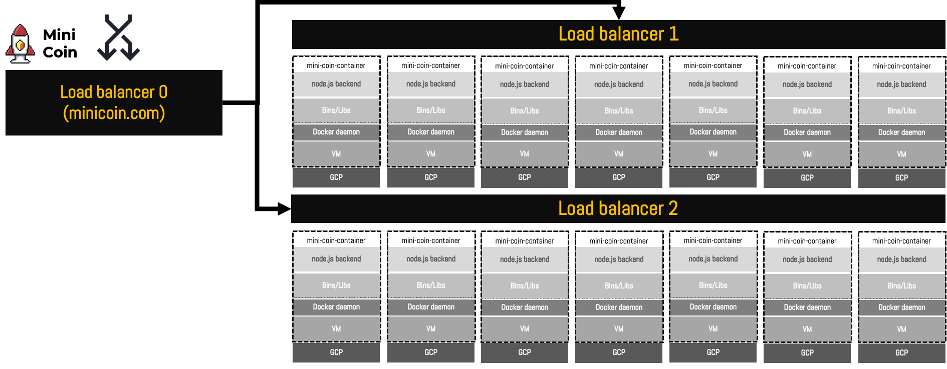
Oh no!
A new crypto coin is now out! We need to update our API!
What can I do?
I scale so much that it’s hard to manage!
I will need to hire an Ops guy!
Or a solution to automate this?
Better: a solution to orchestrate my infrastructure?
I need Kubernetes! ☺

Slide 16

What is Kubernetes?
Kubernetes comes from the Greek word kevernitis (κυβερνήτης) that means “helmsman or pilot”.
There you go!
In 2014, Google released Kubernetes as an opens source software!
They donated Kubernetes to the Cloud Native Computing Foundation
… that serves as the vendor-neutral home for many of the fastest-growing open-source projects, including Kubernetes, Prometheus, and Envoy.
Google used containers in scale long before Docker for their services:
Search and Gmail

Slide 17
Kubernetes
Kubernetes aka K8s
It is an open-source system for automating deployment, scaling, and management of containerized applications
Features:
Planet scale deployments
Google deploy billions of containers per week!
Flexibility
It grows with you to deliver your applications consistently and easily no matter how complex your needs are

Slide 18
Kubernetes & Docker
Docker is amazing! It’s fast, efficient and easy to use
Automation using Dockerfiles and DockerHub makes it easy to set up and use
It can help us automate processes e.g., from my laptop to production, but we need something more!
Something to help Docker run mundane tasks and orchestrate deployments
We need to change our software architecture to support Kubernetes
Kubernetes and Docker work together

Slide 19
Why does Docker not orchestrate?
It does!
It’s called Docker Swarm
Docker swarm is a container orchestration tool, meaning that it allows the user to manage multiple containers deployed across multiple host machines.
2016-2017 we had the orchestrator wars
Docker Swarm, Mesosphere and Kubernetes competed
Long story short:
K8S won!

Slide 20
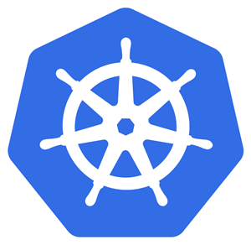
The Kubernetes system
Master Node
The master node(s) host the control plane aspects of the cluster
Kubernetes API server
Scheduler
Controller
Etcd
Workers are the workforce, they run our containers!
Worker Node 1
Worker Node 2
Worker Node 3
kubelet
kubelet
kubelet
kube-proxy
kube-proxy
kube-proxy
Docker
Docker
Docker
VM
VM
VM
GCP
GCP
GCP

Slide 21
kubelet vs kube-proxy
Kubelet (or we can call it node)
An agent that communicates with the master
Kubelet is the technology that applies, creates, updates, and destroys containers on a Kubernetes node
Each node runs a kubelet
Node registers in the API using CPU, memory and storage
Container runtime: Docker
kube-proxy
A network proxy that runs on each node in your cluster
It maintains network rules on nodes

Slide 22

Kubernetes API Server
cubectl
The Kubernetes API server validates and configures data for the API objects:
Pods and services
We use the API server to connect to the Master and run commands
To communicate with the Kubernetes API Server we use a tool called kubectl (pronounced as kube-cattle)
Command line tool ☺
Kubernetes API Server
Master Node
Worker Node 1
Worker Node 2
Worker Node 3
kubelet
kubelet
kubelet
kube-proxy
kube-proxy
kube-proxy
Docker
Docker
Docker
VM
VM
VM
GCP
GCP
GCP

Slide 23
Kubernetes Pods
cubectl
Master Node
Pods are the smallest, most basic deployable objects in Kubernetes
Container < Pod < VM
A Pod represents a single instance of a running process in your cluster
Pods contain one or more Docker containers.
Usually one as in this example!
Pods are created by the Kubernetes scheduler
Worker Node
Pod
mini-coin-container
node.js backend
Bins/Libs`
kubelet
k-proxy
Docker
VM
GCP

Slide 24
Kubernetes deployments
cubectl
Master Node
A Kubernetes Deployment is used to tell Kubernetes how to create or modify instances of the pods that hold containerised apps.
Worker Node 1
Worker Node 2
Worker Node 3
Pod
Pod
Pod
mini-coin-container
mini-coin-container
mini-coin-container
Deployment plan
replicas: 3
image: mini-coin-image
port: 3000
node.js backend
node.js backend
node.js backend
Bins/Libs
Bins/Libs
Bins/Libs
kubelet
kubelet
kubelet
k-proxy
k-proxy
k-proxy
Docker
Docker
Docker
VM
VM
VM
GCP
GCP
GCP

Slide 25
Master: Controller manager
In Kubernetes, a controller watches the shared state of the cluster through the API server and makes changes attempting to move the current state towards the desired state
Some types of these controllers are:
Node controller: Responsible for noticing and responding when nodes go down.
Job controller: Watches for Job objects that represent one-off tasks, then creates Pods to run those tasks to completion.
Endpoints controller: Populates the Endpoints object (that is, joins Services & Pods).
Service Account & Token controllers: Create default accounts and API access tokens for new namespaces.

Slide 26
The cluster store: etcd
Consistent and highly-available key value store used as Kubernetes' backing store for all cluster data.
Check it out: etcd
etcd prefers consistency over availability:
It will not tolerate a split-brain situation and will halt updates to the cluster in order to maintain consistency
Cluster continuous to operate just won’t be able to update

Slide 27
The scheduler
It watches the API server for new work tasks and assign to appropriate nodes.
Nodes (workers) are ranked according to criteria (ranking system is complex)
Are you looking for a project idea?
Good area for research

Slide 28
Workers
The workforce of the cluster
Tasks:
Watch the API for new work assignments
Execute new work assignments
Report back to the control plane (via API)

Slide 29
Packaging apps for Kubernetes
To run on Kubernetes:
Package as a container
Wrapped in a Pod
Deployed via a declarative manifest (YAML)

Slide 30
Scaling pods
Pods are the minimum unit of scheduling
If you need to scale you add pods
You do not scale by adding more containers in the same pod
Pod sharing is for cases that container share resources

Slide 31
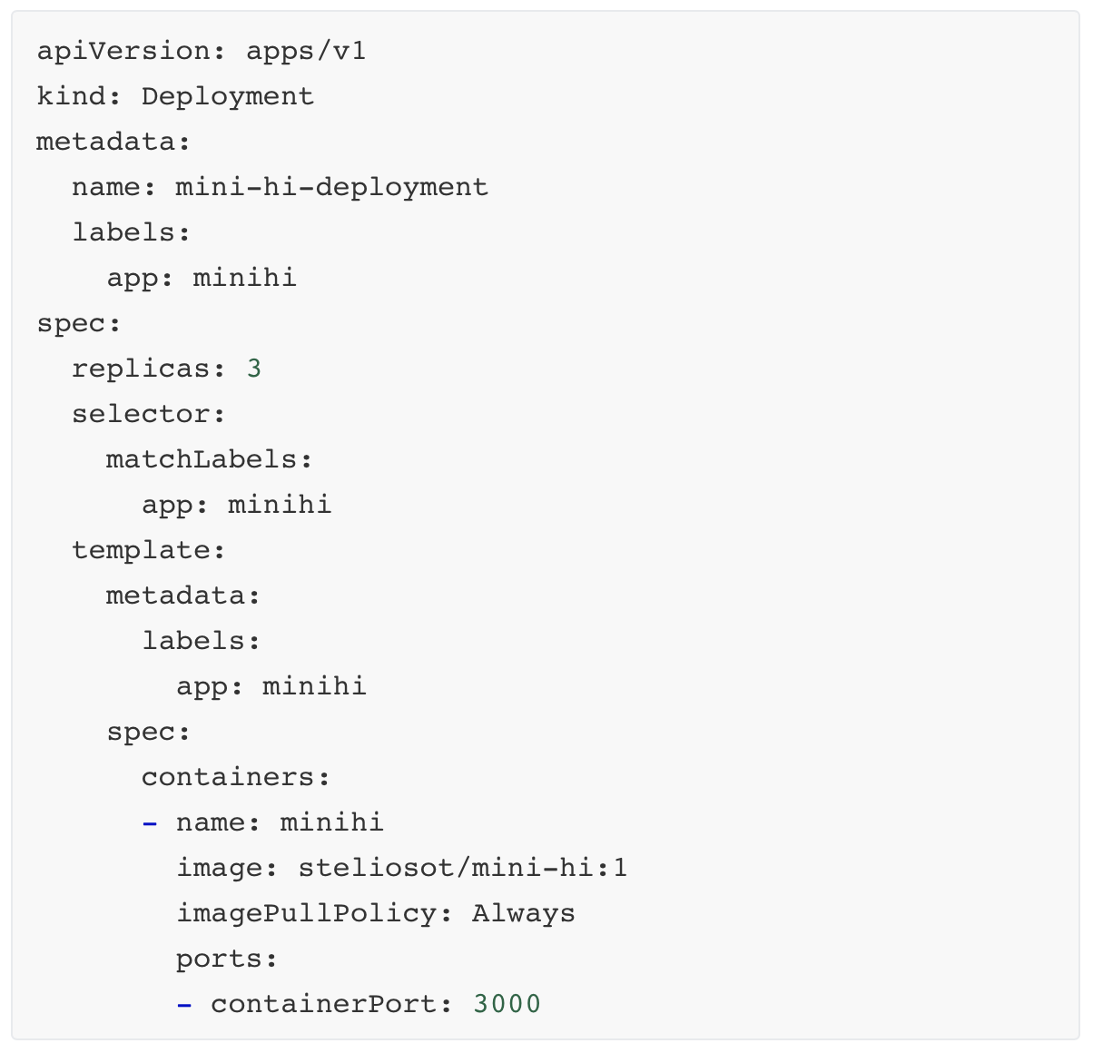
Inspecting a deployment manifest file
Replicas:
The number of instances of the pod that the deployment should keep alive.
template:
When the deployment creates pods, it will create them using this template (image and containerPort)

Slide 32
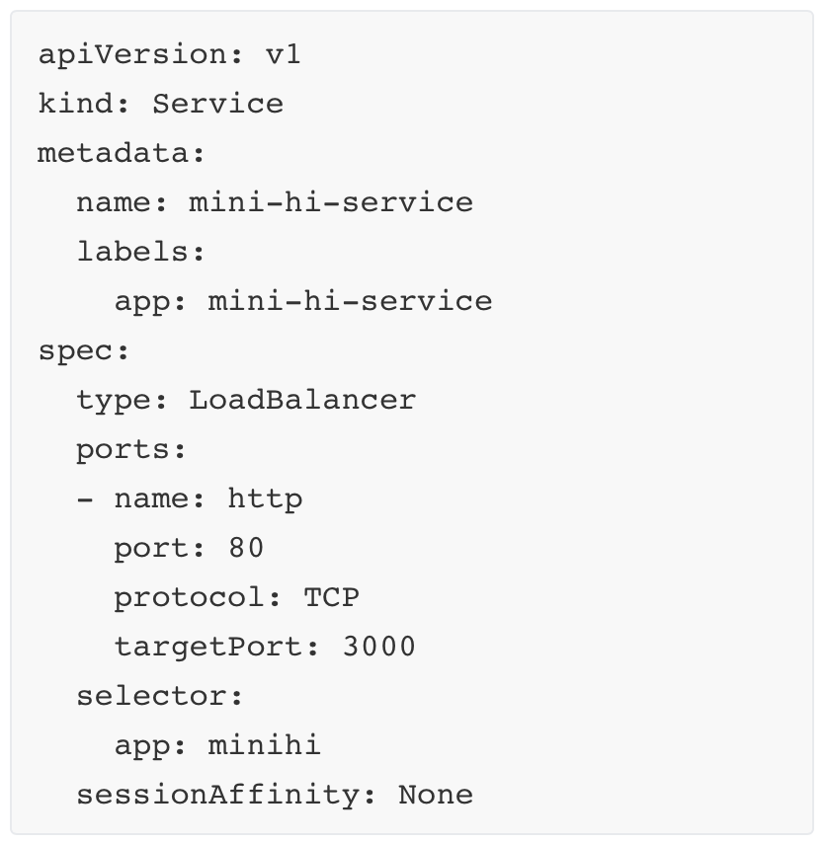
Inspecting a service manifest file
kind: Service (load balancer)
spec:
Mapping container port with pod
Pod 80 → Container: 3000
Selector defines the app (from the deployments file)

Slide 33
Bonus Lab: Google Kubernetes Engine

Slide 34
Google Kubernetes Engine (GKE)
Kubernetes is an open-source software for container orchestration
Focused on automated:
Scheduling
Scaling
Self-healing

Slide 35
GKE Key features
Ingress
External pod IP:
174.13.43.121:80
Pods:
A Pod represents a single instance of a running process in your cluster.
An Ingress controller;
A specialized load balancer for Kubernetes
It abstracts away the complexity of Kubernetes application traffic routing and provides a bridge between Kubernetes services.
Internal node IP: 10.100.1.1
node
Internal pod IP: 10.100.1.100:80
pod
localhost:3000
containerized app

Slide 36
GKE Deployments
A Kubernetes Deployment is a file used to tell Kubernetes how to create or modify instances of the pods that hold a containerized application.
app:mini-hi
replicas:1
node 1
node 2
node 3
pod
pod
pod
containerized app

Slide 37


GKE Deployments
A Kubernetes Deployment is a file used to tell Kubernetes how to create or modify instances of the pods that hold a containerized application.
app:mini-hi
replicas:1
replicas:2
Failure?
node 1
node 2
node 3
pod
pod
pod
containerized app
containerized app

Slide 38
GKE Deployments
A Kubernetes Deployment is a file used to tell Kubernetes how to create or modify instances of the pods that hold a containerized application.
app:mini-hi
replicas:1
replicas:2
node 1
node 2
node 3
pod
pod
pod
containerized app
containerized app

Slide 39
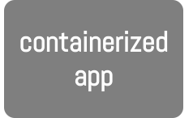
GKE Deployments
A Kubernetes Deployment is a file used to tell Kubernetes how to create or modify instances of the pods that hold a containerized application.
app:mini-hi
replicas:10
node 1
node 2
node 3
pod
pod
pod

Slide 40
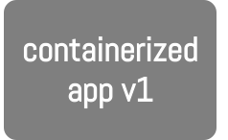
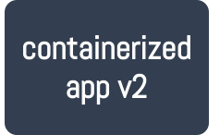
Rolling updates
You can update your software (containers) on the fly.
From
image: mini-hi:1
To
image: mini-hi:2
Service
node 1
node 2
node 3
pod
pod
pod

Slide 41

Todays lab
When you finished, delete your Kubernetes cluster!
Bonus Lab
Class-Bonus
Did you complete Bonus class?
Deploy your MiniPost using a private DockerHub image

Slide 42
Take home
What is Kubernetes?
Why it is important to use Kubernetes?
What problems does it solve?
How do you setup a GKE cluster and deploy an app?

Slide 43
What is Infrastructure as Code?

Slide 44
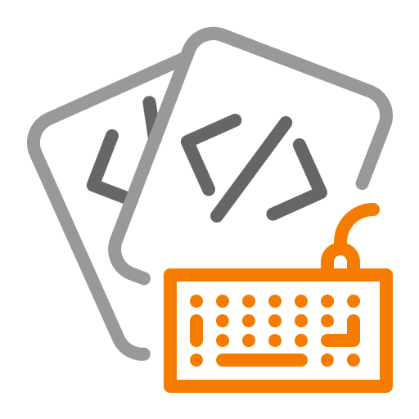





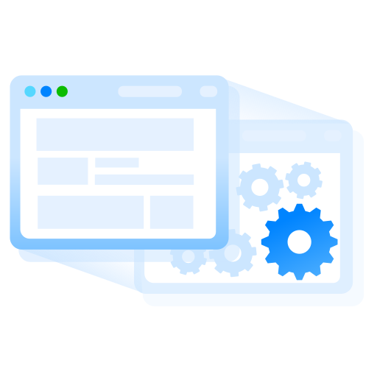



DevOps: from your laptop to production
CD Pipeline
CI Pipeline
Code
Build
Unit Tests
Integration Tests
Review
Staging
Production
Commit

Slide 45
What is infrastructure as code (IaC)?
Infrastructure as Code (IaC) is the managing and provisioning of infrastructure through code instead of manual processes
We create configuration files that contain infrastructure specifications, which makes it easier to edit and distribute configurations
It also ensures that you provision the same environment every time
By codifying and documenting your configuration specifications, IaC aids configuration management and helps you to avoid undocumented, ad-hoc configuration changes

Slide 46
What is infrastructure as code (IaC)?
Version control is an important part of IaC, and your configuration files should be under source control
Deploying your infrastructure as code also means that you can divide your infrastructure into modular components that can then be combined in different ways through automation

Slide 47
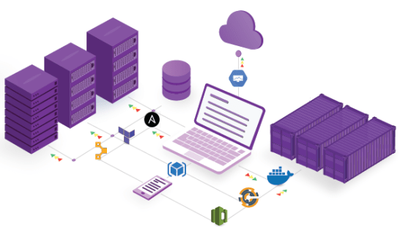
IaC deployment
Automating infrastructure provisioning with IaC means that developers don’t need to manually provision and manage servers, operating systems, storage, and other infrastructure components each time they develop or deploy an application.
You use your code to deploy using configuration files

Slide 48
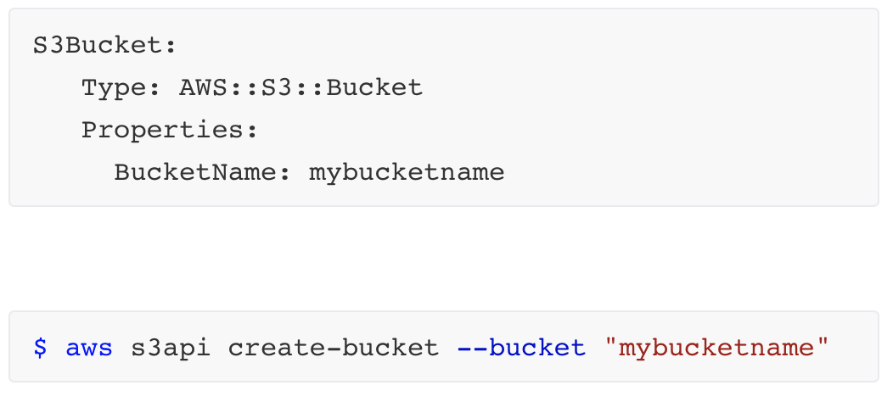
Conf files: Declarative vs. imperative
Declarative approach:
Defines the desired state of the system, including what resources you need and any properties they should have, and an IaC tool will configure it for you.
Imperative approach:
Defines the specific commands needed to achieve the desired configuration, and those commands then need to be executed in the correct order.

Slide 49
Declarative definitions: The preferred approach
A definition file specifies the what an environment requires and not necessarily the how
It may define the specific version and configuration of a server component as a requirement but does not specify the process for installing and configuring it
This abstraction allows for greater flexibility and helps to reduce the technical debt of maintaining imperative code, such as deployment scripts, that can accrue over time
Different platforms support different, and often multiple, file formats, such as YAML, JSON, and XML

Slide 50
Benefits of CI/CD using IaC
Cost reduction:
Manage your infrastructure better
Increase in speed of deployments
Deploy fast and efficient
Reduce errors
Manage IaC configuration files to allow reproducible environments
Improve infrastructure consistency
Declarative definitions help you to redeploy again and again
Eliminate configuration drift
an infrastructure become increasingly different over time, usually due to manual changes and updates

Slide 51
IaC ➞ DevOps ➞ CI/CD
CI/CD relies on ongoing automation and continuous monitoring throughout the application lifecycle, from integration and testing to delivery and deployment
IaC is an important part of implementing DevOps practices and CI/CD.
IaC takes away most of the provisioning work from developers, who can execute a script to have their infrastructure ready to go
That way, application deployments aren’t held up waiting for the infrastructure, and the sysadmins aren’t managing time-consuming manual processes

Slide 52
What is Terraform?
Terraform is an infrastructure as code tool
You define both cloud and on-premises resources in human-readable configuration files that you can version, reuse, and share
You can then use a consistent workflow to provision and manage your infrastructure throughout its lifecycle
Terraform can manage every small detail of a deployment plan

Slide 53
Terraform tool
Terraform community have already written more than 1700 providers to manage thousands of different types of resources and services, and this number continues to grow.
You can find all publicly available providers on the Terraform Registry, including Amazon Web Services (AWS), Azure, Google Cloud Platform (GCP), Kubernetes, Helm, GitHub, Splunk, DataDog, and many more.
The core Terraform workflow consists of three stages:
Write: You define resources, which may be across multiple cloud providers and services.
For example, you might create a configuration to deploy an application on virtual machines in a Virtual Private Cloud (VPC) network with security groups and a load balancer.
Plan: Terraform creates an execution plan describing the infrastructure it will create, update, or destroy based on the existing infrastructure and your configuration.
Apply: On approval, Terraform performs the proposed operations in the correct order, respecting any resource dependencies.
For example, if you update the properties of a VPC and change the number of virtual machines in that VPC, Terraform will recreate the VPC before scaling the virtual machines.

Slide 54
What is GitOps?
GitOps is an operational framework that takes DevOps best practices used for application development such as version control, collaboration, compliance, and CI/CD tooling, and applies them to infrastructure automation.
The Terraform integration features in GitLab enable your GitOps / Infrastructure-as-Code (IaC) workflows to tie into GitLab authentication and authorization.

Slide 55

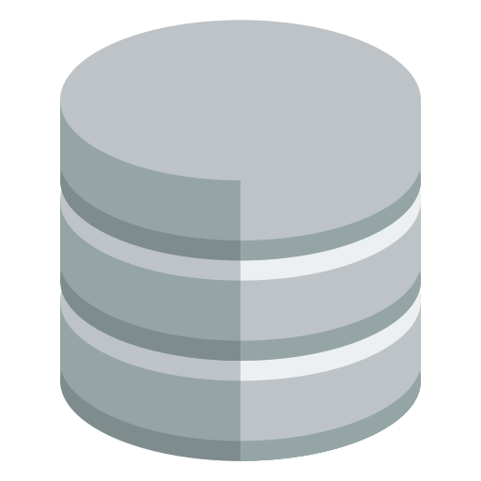
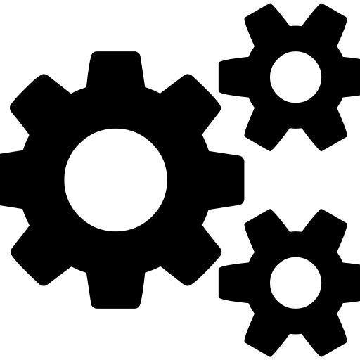

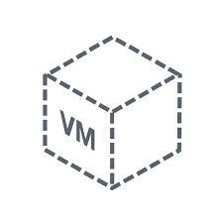

CI/CD pipeline with GitHub actions
Setting up an environment (VM)
push
trigger
run terraform plan
Developer
Code
Repository
GitHub
Actions (GitOps)
Deployment
Deployment plan
Configurations
Docker
Terraform
…
Networks
Instance
…

Slide 56
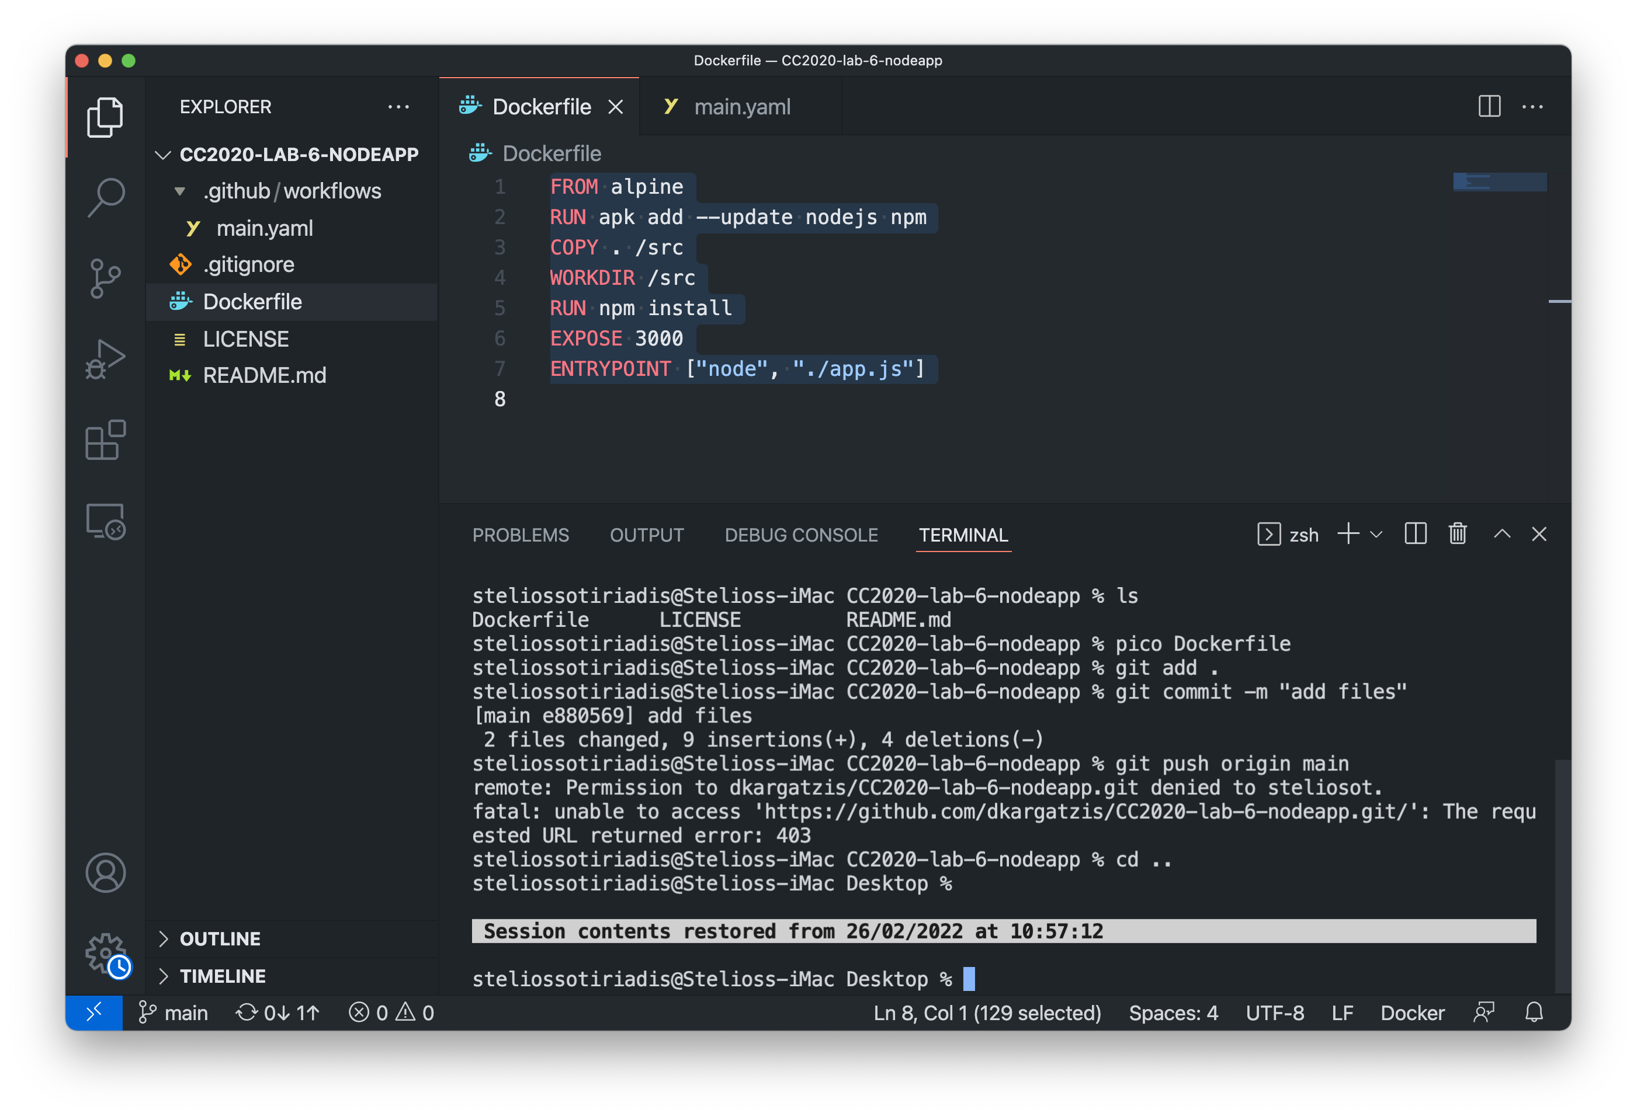
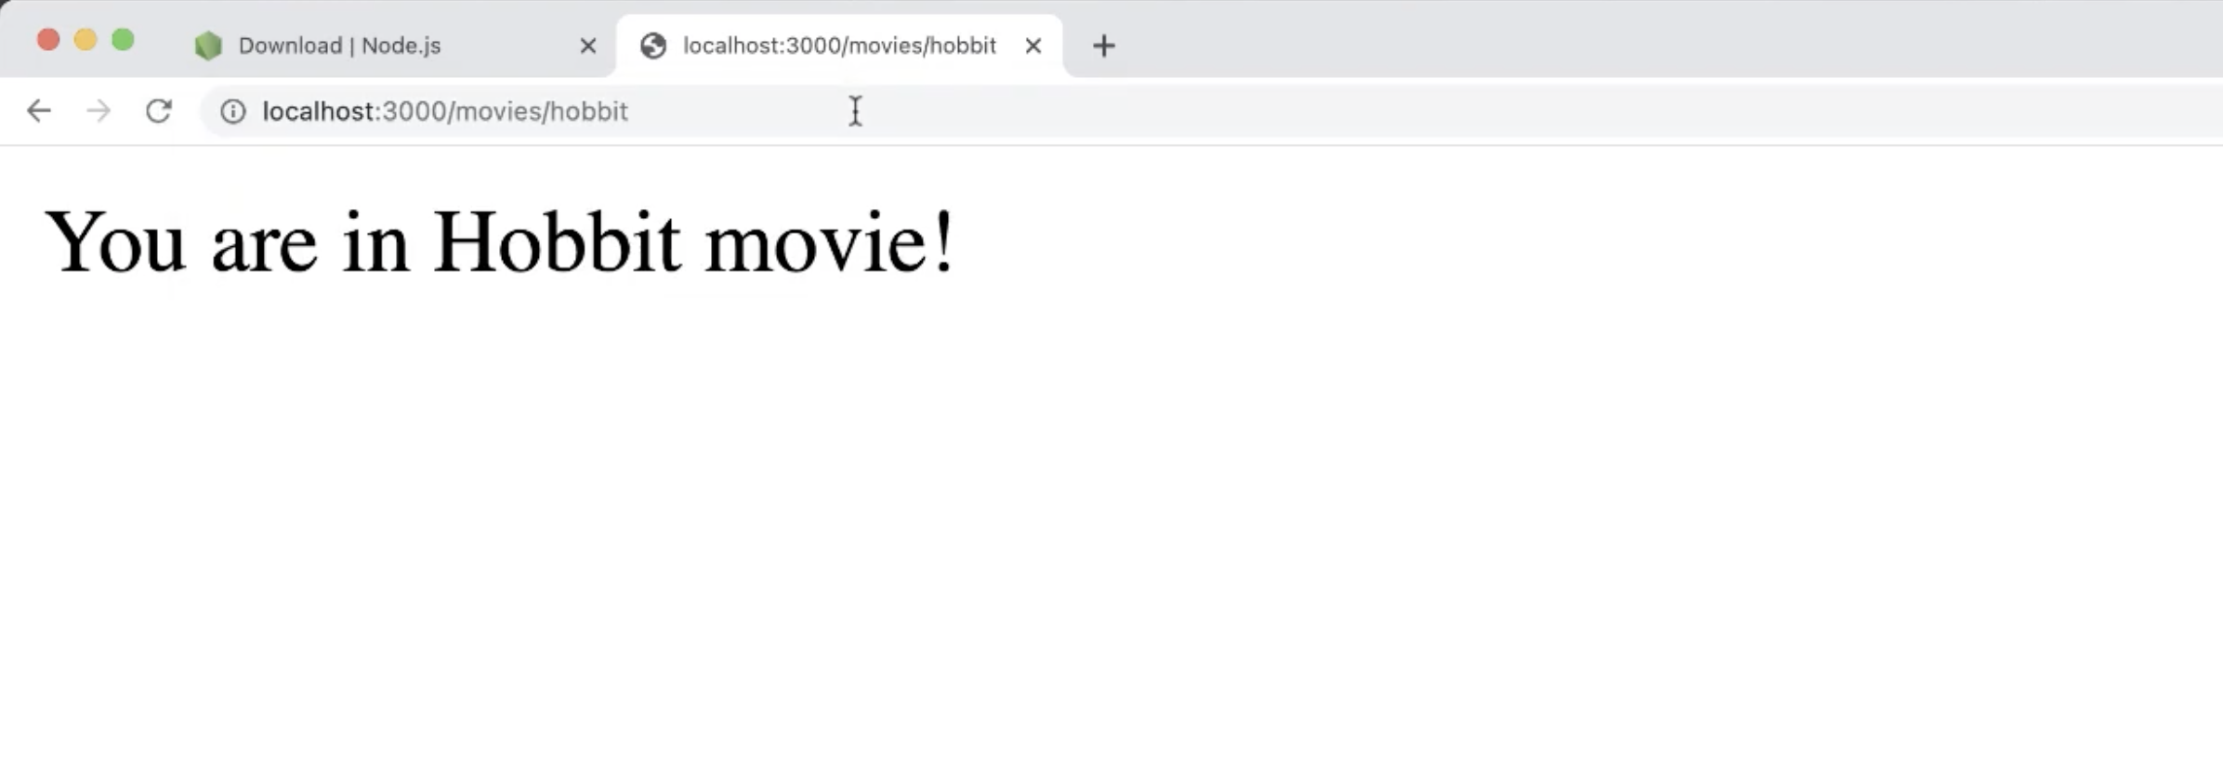
CI/CD pipeline with GitHub actions
Environment is up! Let’s setup a node deployment plan
Hide deployment
push
trigger
run terraform plan
Developer
Code
Repository
GitHub
Actions (GitOps)
Deployment

Slide 57
Demo: Building a GKE cluster

Slide 58
Building a GKE cluster
Intro to Kubernetes
Create a cluster and deploy containers
Building Docker images and pushing code to GitHub, DockerHub and Kubernetes

Slide 59
Practical Session

Slide 60

Deployment using Docker
Run the tutorials:
Introduction to GKE
GKE Command Line tool
Using GitHub, DockerHub and Docker to deploy and run containers
Exercises:
Deploy your Docker containers in GKE

